Slide 1
Speckle-Based Reservoir Computing & Echo State Networks
Jacob Pilawa, Uttam Paudel, Marta Luengo-Kovac, George Valley, Justin Shaw
08 August 2019

Slide 2
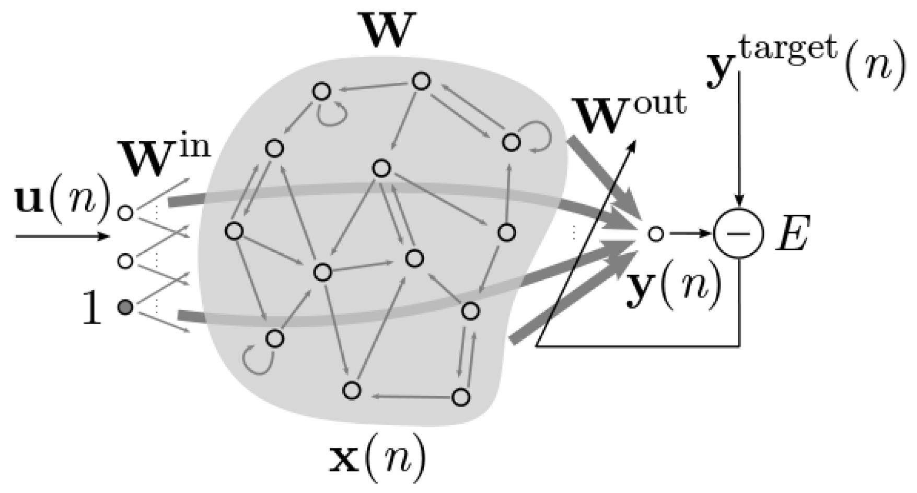
Overview
What’s coming?
Background of neural networks
Echo state networks & Reservoir Computing
“Running” an echo state network
Optical implementation of an echo state network
Day-to-day work
Japanese Language Optical ESN Case Study
Results and Analysis
What else is there to do?
TAKEAWAY: Story of my summer exploring echo state networks and optical computing.
Figure: Melidis et al., 2019

Slide 3
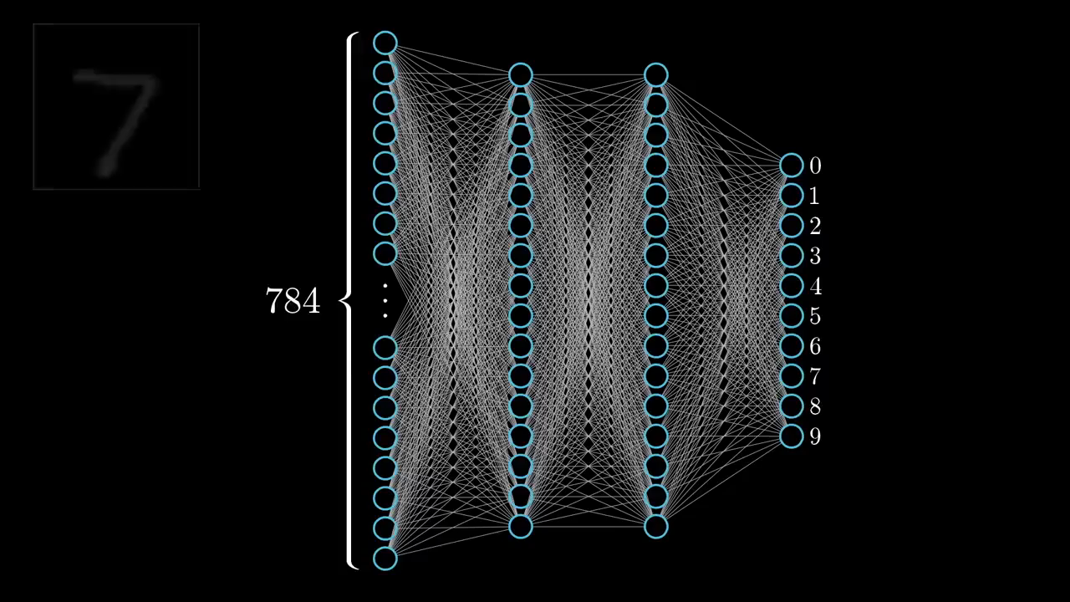
Neural Networks
A bit of background…
Mesh network of “connected” layers of “neurons” that try to find abstract features in datasets
Neuron : a thing that holds a number and pathways to other neurons
Network : neurons from layer to layer are connected and can influence each other
Goal : Train the neural network (i.e., figure out the best set of connections) for a given task so that it can make predictions in the future
Animation: 3Blue1Brown, YouTube
TAKEAWAY: A neural network, plain and simply, is a function that takes inputs and maps them to a desired output after it has been “trained” to do so.
Notes:
Neural networks are a type of machine learning and can be seen as a mesh network of connected layers of neurons
Because it’s a machine learning paradigm, it attempts to find abstract features in datasets by having the network “learn”
If you don’t know much about neural networks, all you need to know is that a “neuron” can be thought of as something that holds a number and can influence other neurons
So the goal is to figure out the right way to connect the neurons to achieve a task, classification, or prediction
The video here is an example of a neural network architecture. Let’s say you are trying to take a hand-drawn image of a number and want to teach a computer to recognize it. You can send the pixel values of the drawing through the network, and the inputs will propagate through, exciting the right combination of neurons so as to be properly classified.

Slide 4
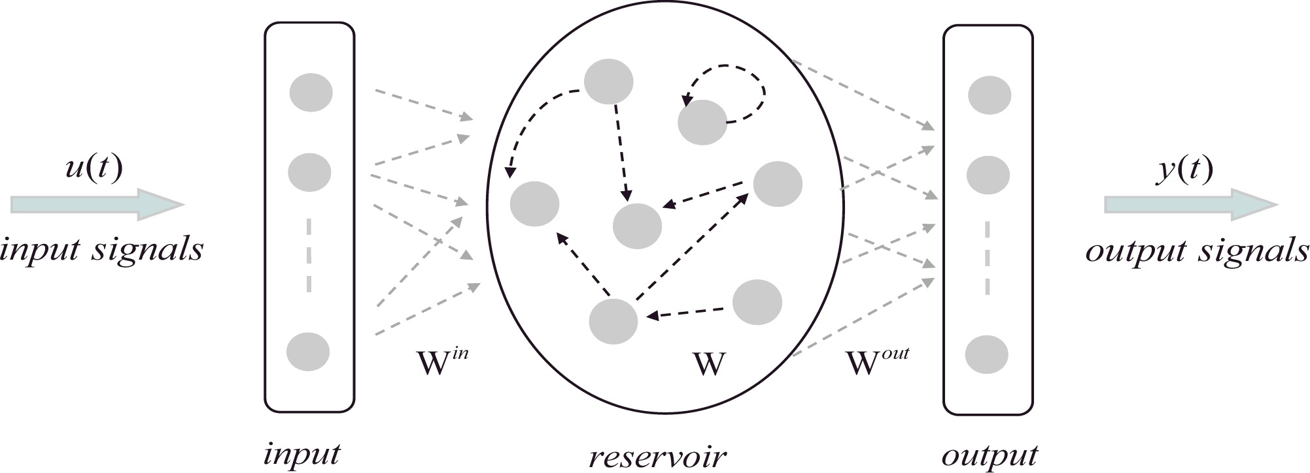
Reservoir Computing / Echo State Networks
Training the output, not the method
Echo State Networks (ESNs) are a type of reservoir computer (RC), which itself is an extension of neural networks
Key Aspects
Connections between neurons are random and fixed whereas traditional neural networks train all connections
Huge reservoir size + non-linear transfer function (connections) + Feedback connections = Captures non-linear, temporal dynamics of “real” systems
Training is performed on a single layer of neurons using simple regression techniques (and thus computationally efficient)
APPLICATIONS: Speech recognition, time-series predictions, signal classification, denoising, demodulation, on-the-fly signals intelligence, etc.
Figure: Ma et al., 2016
Notes:
Now that the basics of a traditional neural network are understood, we can look at the echo state network/reservoir computer as a type of neural network.
There are a few key differences between the network I just showed of the hand-drawn digits and the type of network I was working on called an echo state network
All the connections are random and fixed from the start;
The number of neurons is typically much larger than a traditional neural network; in addition, echo state networks have a non-linear transfer function between time steps. These two components of echo state networks give it great predictive ability for non-linear data and temporal data
Whereas the connections in the previous network are all trained and tuned to give the right outputs, an echo state network only cares about the last layer (called the output layer) of connections
This makes echo state networks computationally efficient and therefore much more quickly trained
Given that ESNs are good at non-linear, temporal dynamics, speech recognition, time-series predictions, signal classification, denoising, demodulation, on-the-fly signals intelligence, and much more becomes possible with this architecture

Slide 5
An Echo State Network in Operation
A look under the hood.
u₁(t)
x₁(t)
y₁(t)
x₆(t)
u₂(t)
x₇(t)
y₂(t)
x₂(t)
x₅(t)
x₃(t)
x₄(t)
u_{N}(t)
y_{k}(t)
Generate a large, random reservoir (W^{in}, W).
Run every training input u(t) through the reservoir, collecting how the reservoir responds to each input x(t).
Compute W^{out} from these activation states x(t) using linear regression, minimizing the error between y(t) and y^{target}(t).
Use the trained network on new input data u^{test}(t), computing y^{predict}(t) using the trained output weights W^{out}.
TAKEAWAY: Echo State Networks work by inputting a signal, seeing how the reservoir responds, and making predictions based on that response.
Figure: Ma et al., 2016
Notes:
Let’s now take a look at exactly what we mean when we say we “run” an echo state network

Slide 6
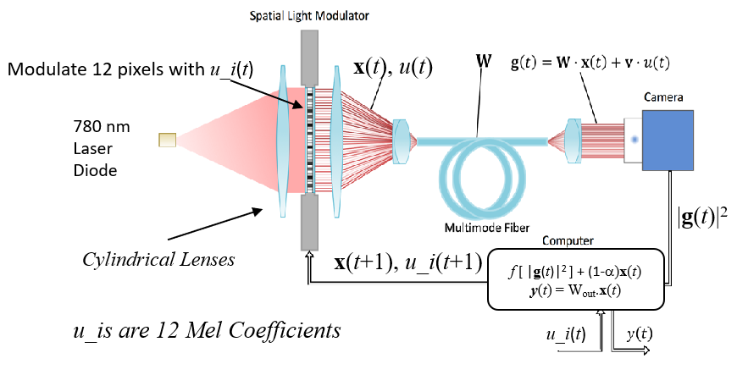
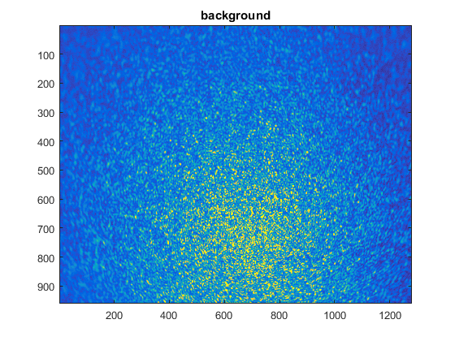
Optical Echo State Networks
Implementing neural networks in the lab
MOTIVATIONS + TAKEAWAYS: Using photonics, we can automatically perform the matrix multiplications “at the speed of light.” This system implements an echo state network by using a speckle pattern as a substitute for electronic computation.
Speckles output from the fiber
Encode the input as voltages into the pixels of the spatial light modulator (SLM).
Pass output of SLM into a multimode fiber to generate speckle pattern.
Apply non-linearity and feedback fraction of previous neurons to obtain new neuron values from speckle image.
Inject these neurons back into the SLM. Store this at each time step to build X(t).
Calculate W^{out} from X(t) using Y(t) = W^{out}X(t).
Run the system on new data to obtain an X^{test}(t). Recover input and classify by
Y^{test}(t) = W^{out}X^{test}(t).

Slide 7
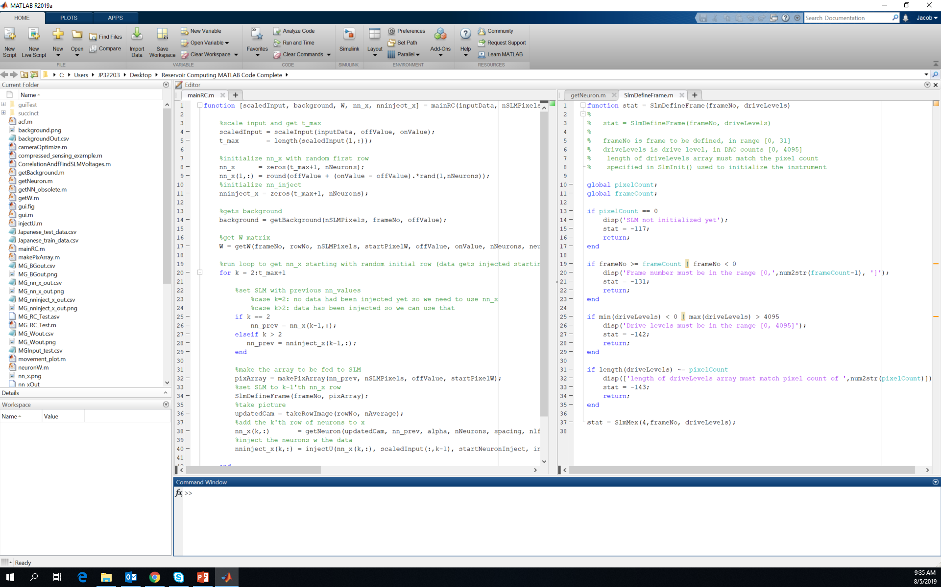
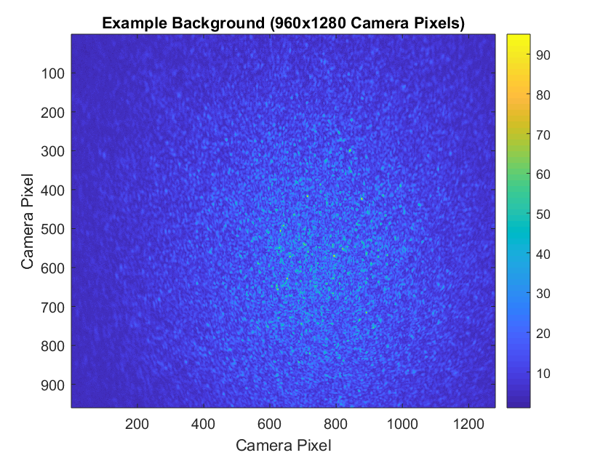
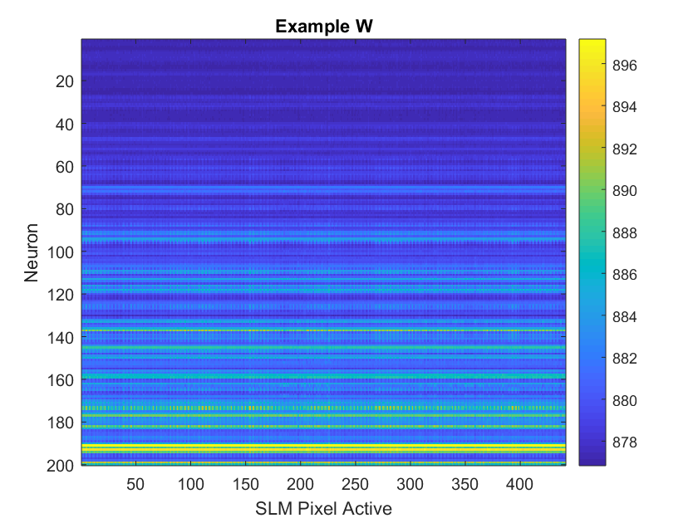
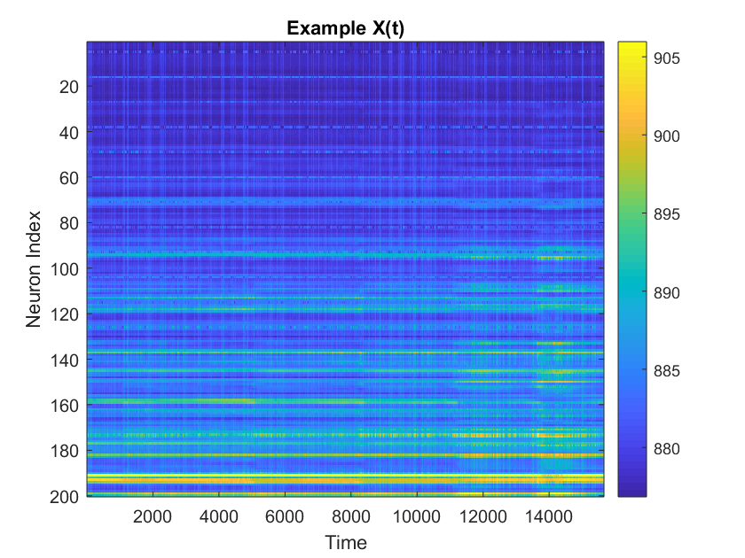
What did I do?
A look into the day-to-day…
GOAL: Interface the SLM, the CCD camera, and the data acquisition into a flexible package of MATLAB .m files for easy data collection from the ESN.
mainRC.m, getBackground.m
scaleInput.m, getW.m
getNeuron.m, injectU.m, neuronW.m
takeRowImage.m, makePixArray.m
SlmDefineFrame.m, SlmSelectFrame.m,

Slide 8
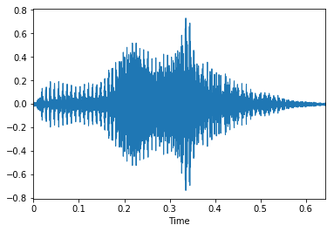
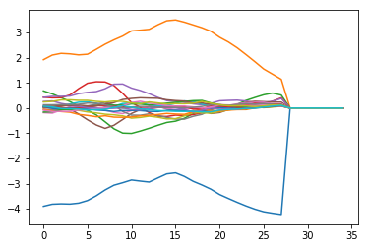
Optical ESN in Action
A Japanese language classification case study.
Nine male speakers uttered two Japanese vowels /ae/ successively
The audio files are pre-processed to generate Mel-frequency cepstrum coefficients (MFCC)
Think of MFCCs being representations of the power spectrum of a sound
Each sequence consists of a time series of 12 MFCC coefficients
GOAL: Given audio data, classify spoken Japanese vowels by speaker (1-9) using an optical reservoir computer.
“One” (.wav file)
MFCCs
Plots: M. Luengo-Kovac

Slide 9
Experimental test of the optical reservoir computer
Training and Test Input
Neurons Output
Reservoir
Computer
Send input u_{i}(t) to 12 pixels of SLM
Take an image of the speckle pattern on the computer
Convert pixel values to neuron values
x(t+1) = α f [ W x(t) + v u_{i}(t)] + (1 – α) x(t)
Inject feedback “neurons” x(t+1) to SLM
Store vectors into X matrix of neurons for duration of training sequence
Calculate output weight W_{out} matrix from training data and neuron matrix
Y(t) = W_{out}X(t)
Continue running system to obtain test neuron matrix X
Multiply test neuron X matrix by W_{out} to recover waveform and classify
9 different speakers’ MFCC coefficients ( Y_{predict} = W_{out}X_{test})
The features of the 12 inputs get mapped to 200 neurons. This enables important data features to be extracted automatically through the training process.

Slide 10
Input vs prediction of the Mel coefficients waveform
First 140 time steps of the prediction
TAKEAWAY: All features of the Mel coefficients are well captured by the RC.

Slide 11
Input vs prediction of the Mel coefficients waveform
First 1000 time steps of the prediction
Blue: Input waveform
Orange: Reconstructed waveform
Waveform reconstruction is good but not perfect!

Slide 12
Classification accuracy
Can successfully predict the speaker with never seen training data
First 270 audio inputs are used as training.
Remaining 270 are used for test/prediction.
Overlap of red cross and black square correspond to correct predictions.
Obtain ~73% accuracy with regularized regression
Random Guess Accuracy: ~11%
TAKEAWAY: Successfully classified audio files using optical RC.

Slide 13
Classification Accuracy from Multiple Runs
Successfully classified audio files using optical RC.

Slide 14
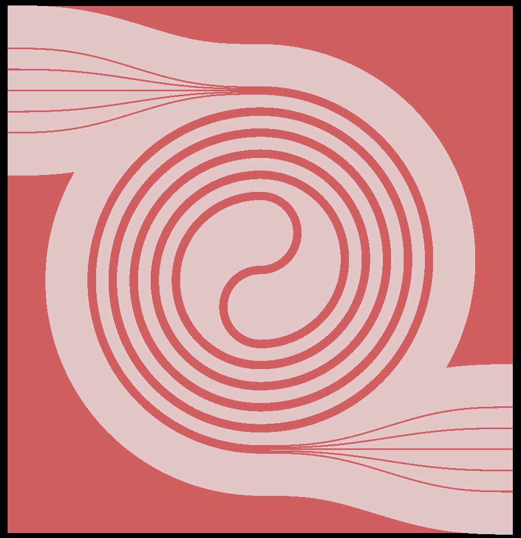
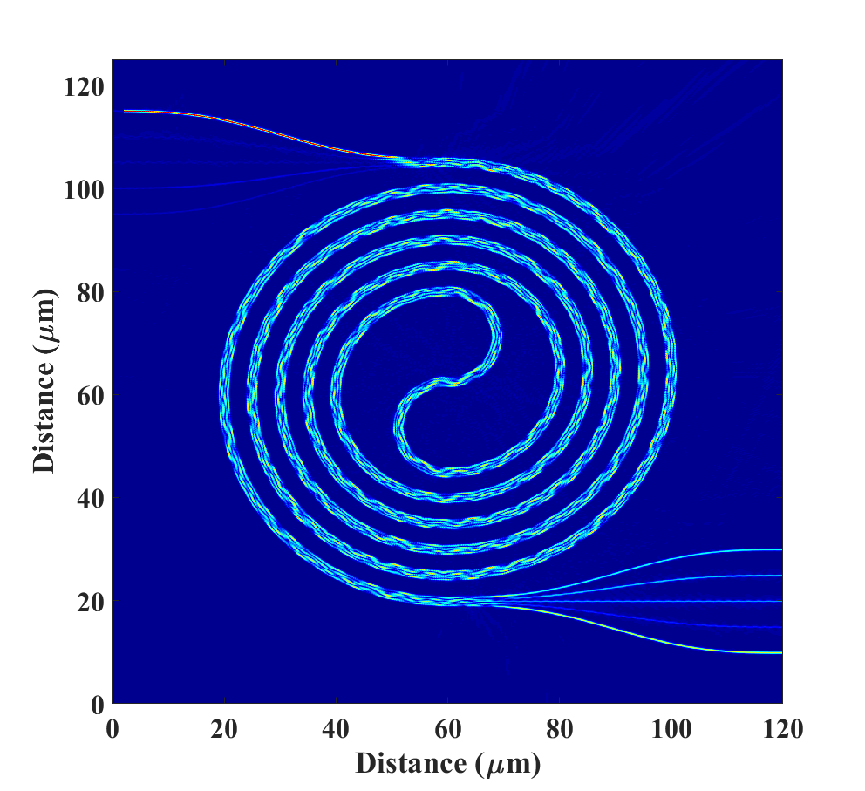
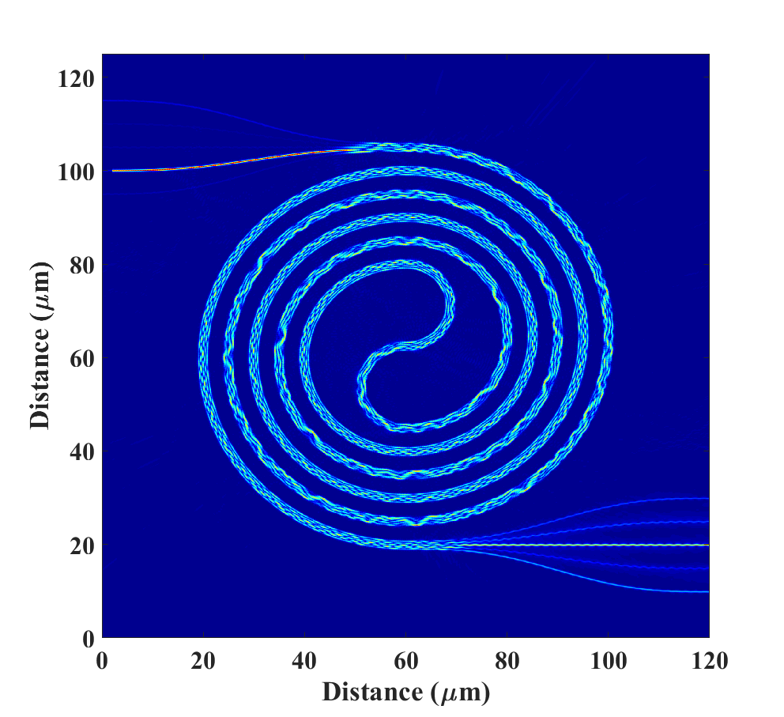
Toward the future…
What are the next steps?
Short Term
Improve the speed of data acquisition + processing
Stability of the optics (thermal stability, vibrational stability, etc.)
Optimize the kinds of problems and parameter space in which we operate echo state network
Understand the effect of noise and drift on the experimental setup
Increase number of nodes + compare simulation optimized parameters with experimental optimized parameters
Long Term
Robust signal classification
Raw data processing (instead of intermediate MFCC-like steps)
Photonic integrated circuit for echo state networks
Example of planar waveguide on SOI platform
Simulated propagation for different input ports
CONCLUSION: Much progress has been made, but as always, there is more to do.
Notes:
Now that the basics of a traditional neural network are understood, we can look at the echo state network/reservoir computer as a type of neural network.
There are a few key differences between the network I just showed of the hand-drawn digits and the type of network I was working on called an echo state network
All the connections are random and fixed from the start;
The number of neurons is typically much larger than a traditional neural network; in addition, echo state networks have a non-linear transfer function between time steps. These two components of echo state networks give it great predictive ability for non-linear data and temporal data
Whereas the connections in the previous network are all trained and tuned to give the right outputs, an echo state network only cares about the last layer (called the output layer) of connections
This makes echo state networks computationally efficient and therefore much more quickly trained
Given that ESNs are good at non-linear, temporal dynamics, speech recognition, time-series predictions, signal classification, denoising, demodulation, on-the-fly signals intelligence, and much more becomes possible with this architecture

Slide 15
Thank you!
A special thanks to Uttam Paudel, Marta Luengo-Kovac, George Valley, Justin Shaw, and all the interns for the incredible
experience and support.

Slide 16
Backup Slides/Extra Information
(Thanks to Uttam Paudel & Marta Luengo-Kovac)

Slide 17
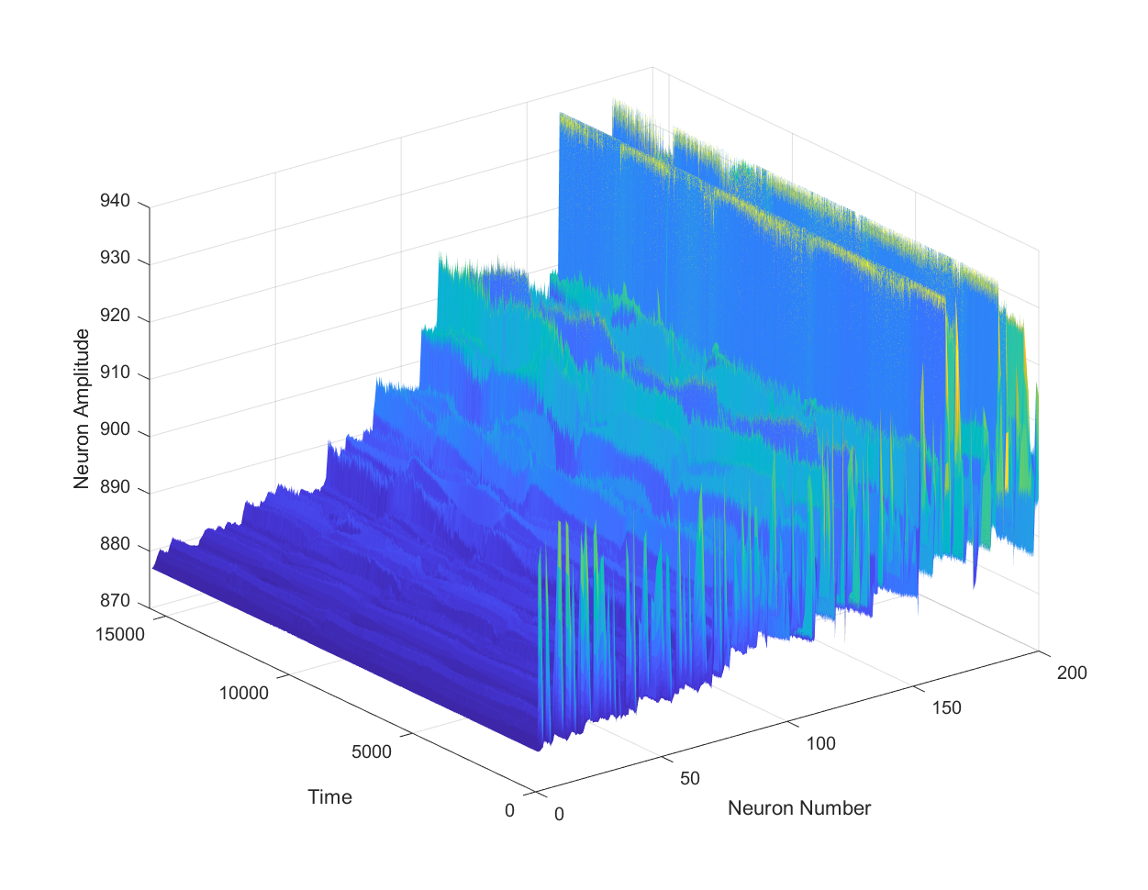
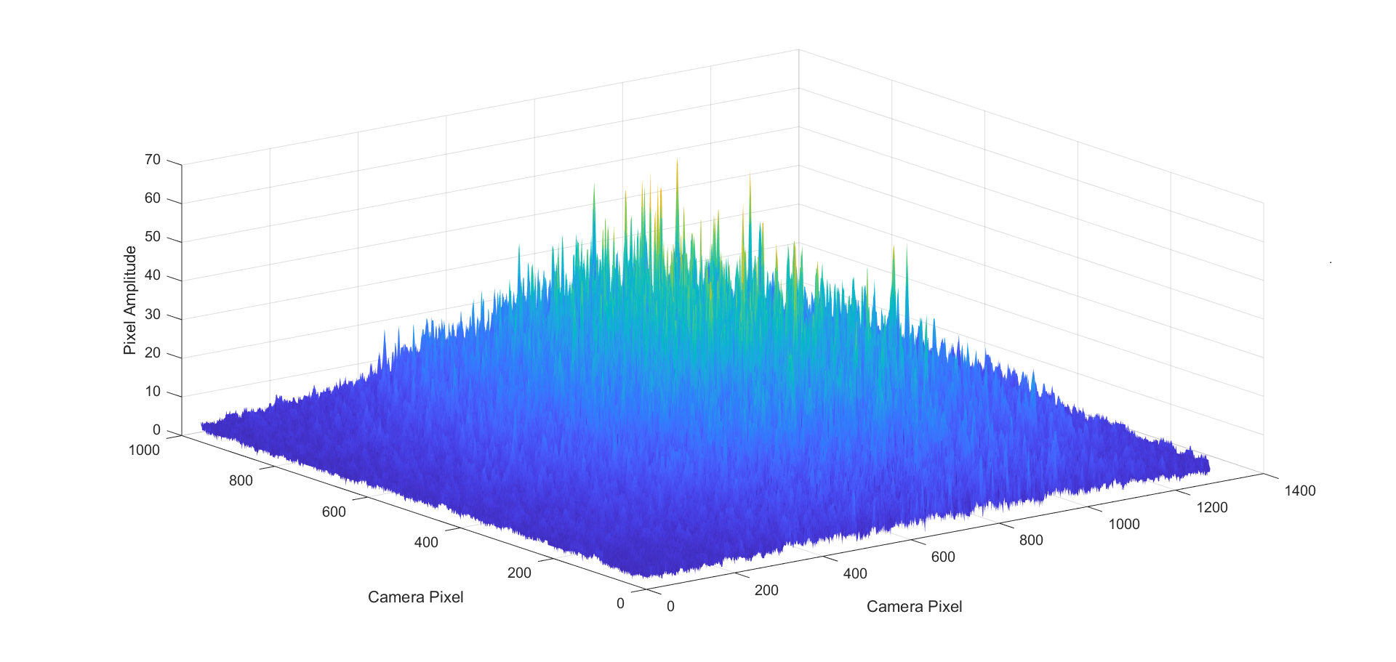
Visualizations
Neuron Value vs. Time
Background

Slide 18
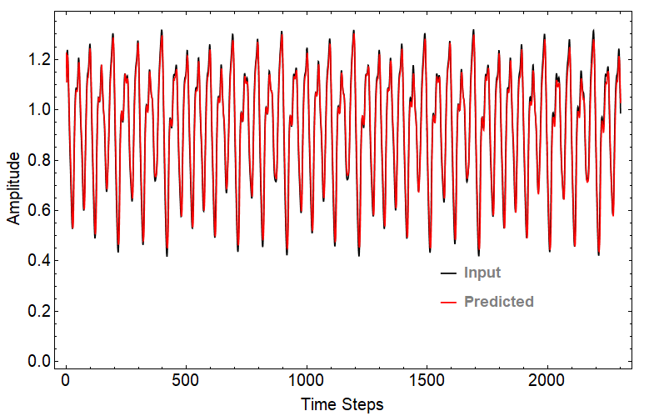
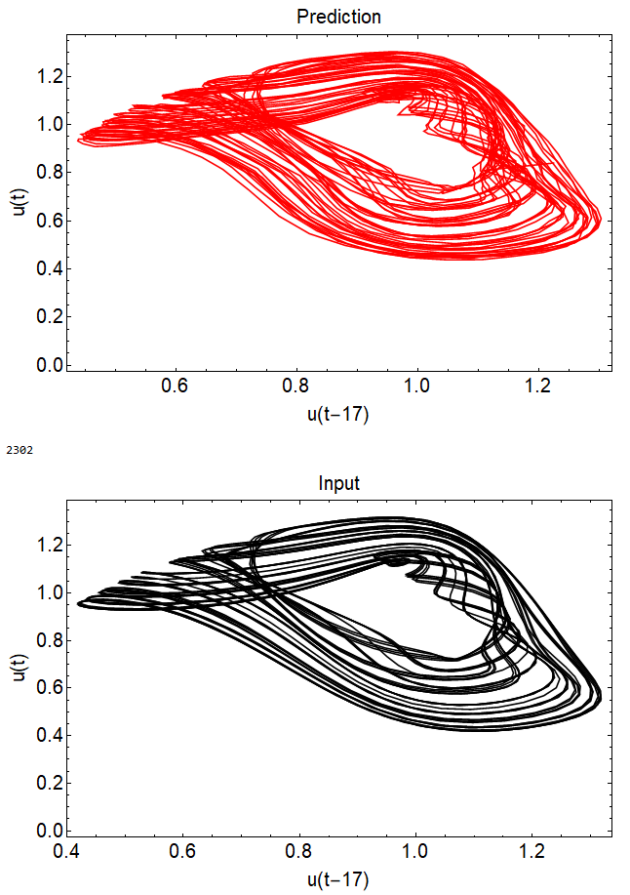
Mackey-Glass non-linear time-series prediction
Mackey-Glass function gives a complex, near-chaotic dynamics and is extremely difficult to predict.
A Mackey-Glass time-series is mapped using the optical hardware. The system can map-out the series with high accuracy.
Chaotic attractor for the input and prediction generated from the time delayed MG input. The plots show that the system operates in a high-dimensional regime and our optical reservoir computer is fully able to map the dynamics.
Waveguide speckle-based optical reservoir computer can map near-chaotic dynamics

Slide 19
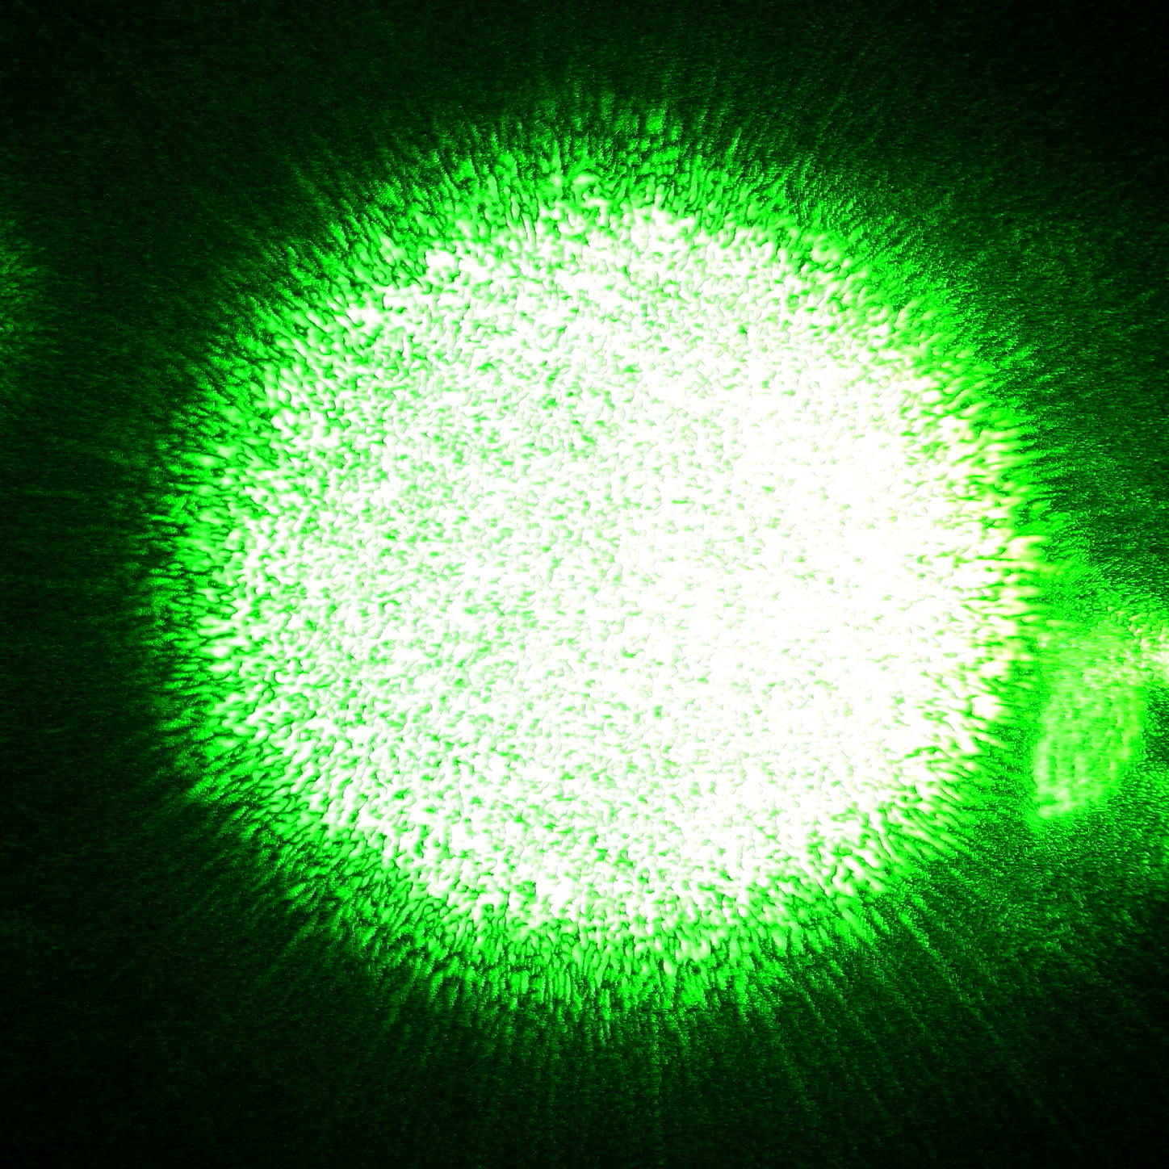
What is speckle?
Pattern of light on a surface produced by mutual interference of wave fronts
Typically occur in diffuse reflection of monochromatic light (like laser light)
Results because different phases and amplitudes add to give a resultant, random pattern of light

Slide 20
Mathematical Formulation of Echo State Networks
x(t+1) = α f [ W x(t) + v u_{i}(t)] + (1 – α) x(t)
y(t) = W^{out}x(t)
x(t) are the values of the neurons at time t
α is the “leaking rate”
f is the nonlinear sigmoidal function (e.g. tanh(x), sigmoid)
W and v are the random weight matrices from speckle
u_{i}(t) are the input signals
y(t) is the output signal
W_{out} is the vector of output weights
X_{training} = {x(0), x(1),…, x(n_{training})}
W_{out} = (X_{training})^{PseudoInverse} Y_{training}
X_{test} = {x(n_{training}+1),…,x(n_{training}+ n_{test})}
Y_{test} = W_{out} X_{test}
n_{training} = length of training data
n_{test} = length of test data

Slide 21
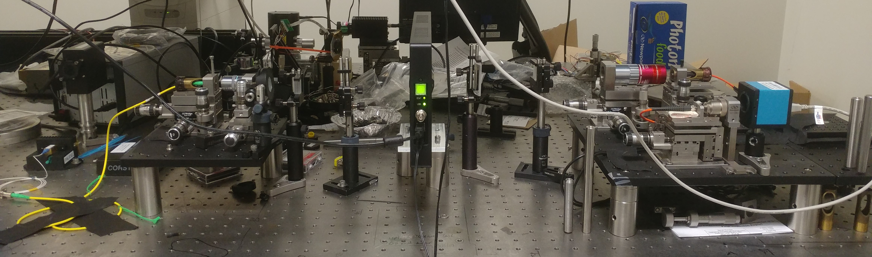
Experimental Layout
SLM
MM Fiber
Laser
Cylindrical
Lens
Camera

Slide 22
Japanese Language Classification
Slide from Marta Luengo-Kovac + Uttam Paudel
GOAL: Classify spoken Japanese vowels into their corrects bins using an optical reservoir computer.
Nine male speakers uttered two Japanese vowels /ae/ successively
The audio files are pre-processed to generate Mel-frequency cepstrum coefficients (MFCC)
Each sequence consists of a time series of 12 MFCC coefficients
Training set: 270 sequences (30 utterances by 9 speakers)
Testing set: 270 sequences (24-88 utterances by the same 9 speakers)
Length of time series: 7-29 depending on the utterance
The task is to classify speakers using the optical RC

Slide 23
Mel-frequency cepstrum coefficients
Widely-used method for speech classification
Slides from Marta Luengo-Kovac + Uttam Paudel
The mel-frequency cepstrum is essentially the spectrum of the power spectrum of a sound
Compute the power spectrum of a signal
Bin the power spectrum based on the mel scale (this scale more closely matches the human auditory system – e.g. less sensitive at higher frequencies)
Take the log of the power at each mel frequency (because human hearing follows a log scale)
Take the discrete cosine transform of the mel log powers to get the spectrum of the log of the power spectrum
The MFCCs are the amplitudes of the resulting spectrum
Generally only coefficients 2-13 are used (the first coefficient is usually a large offset and the higher coefficients are mostly high frequency noise)
“One” (.wav file)
MFCCs

Slide 24
System stability (Experiment)
Training and test were taken over 6 hours time window.
Integrated photonics should allow >GHZ processing, training would take microsecond time.

Slide 25
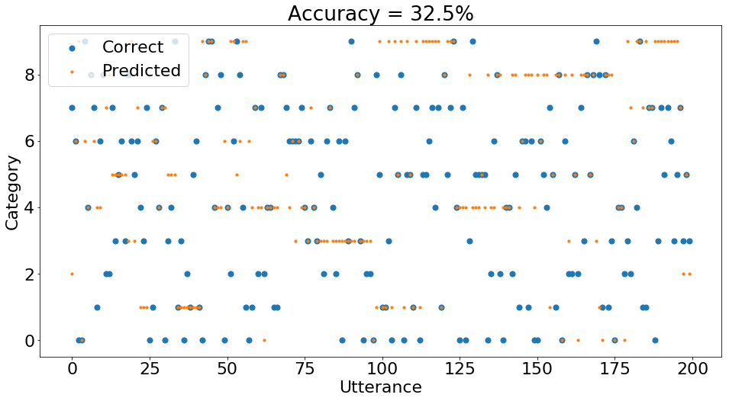
English spoken digits classification
Four speakers with different accents
The 10 English digits were spoken 10 times each by 4 different speakers (2 with American accents, one with a French accent, one with a German accent).
Of those 10 times, half data were used for training and half were used for testing, resulting in 200 training utterances and 200 testing utterances.
The raw data was the waveform of each utterance. This was converted into its mel-frequency cepstrum coefficients before being fed into the RC.
The prediction dataset are not seen during the training period.
Obtain 32.5% accuracy which is above random chance (10%).
The lower accuracy might be due to multiple speakers with different accents.
Longer training dataset should increase the accuracy.
Above random guess classification for English spoken digits problem.

Slide 26
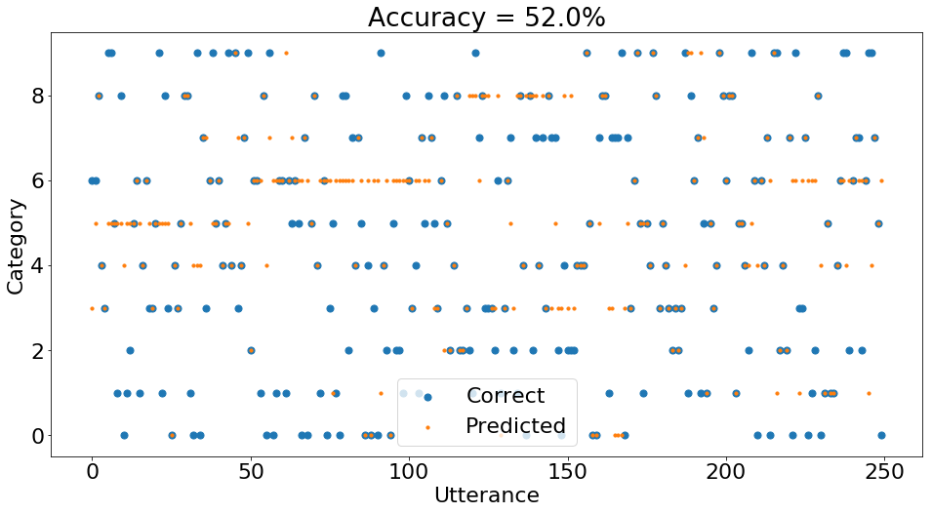
English spoken digits classification
Single speaker
The 10 English digits were spoken by a single speaker.
Half data were used for training and half were used for testing, resulting in 200 training utterances and 200 testing utterances.
The raw data was the waveform of each utterance. This was converted into its mel-frequency cepstrum coefficients before being fed into the RC.
The prediction dataset are not seen during the training period.
52% classification accuracy for English spoken digits by a single speaker.

Slide 27
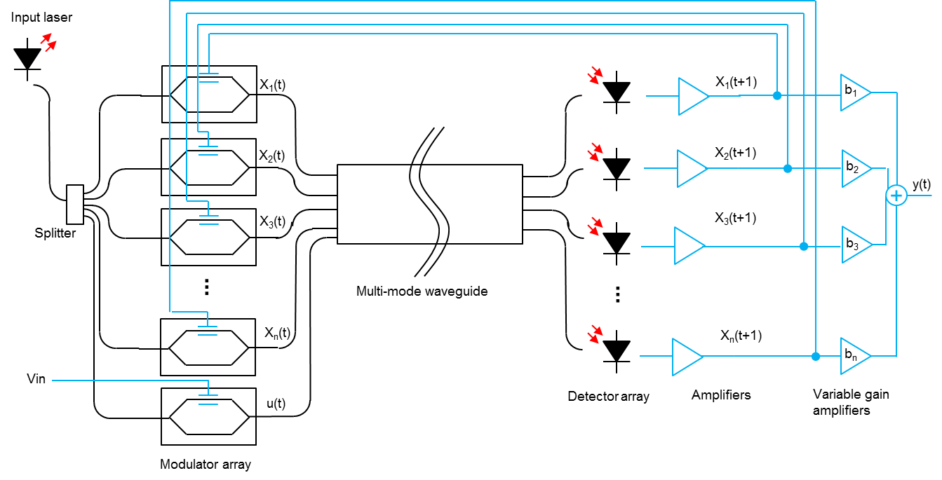
Chip-scale integrated photonics reservoir computer
Lasers can be fabricated (InP) or chip-mounted (Si)
Modulators array could be build using electro-absorption devices (InP) or compact ring modulators (Si).
Planar multimode waveguide in silicon is verified to generate the speckles as predicted.
Germanium detectors can be fabricated on silicon platform.
All components can be readily fabricated on an integrated platform using a commercial foundry.
A schematic for an optical reservoir computer implemented on photonic integrated circuit.
Top-view
Example of planar waveguide on SOI platform
Simulated propagation for different input ports
Clear path-forward for building integrated photonics circuit. Can achieve>GHZ processing with a PIC, training would take ~microsecond time.

Slide 28
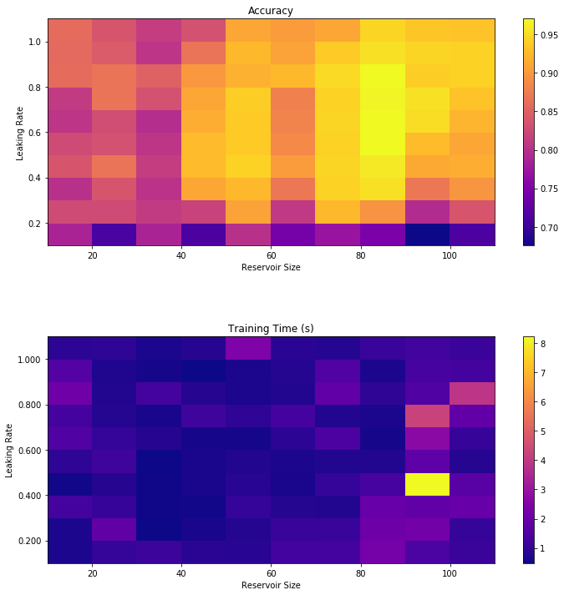
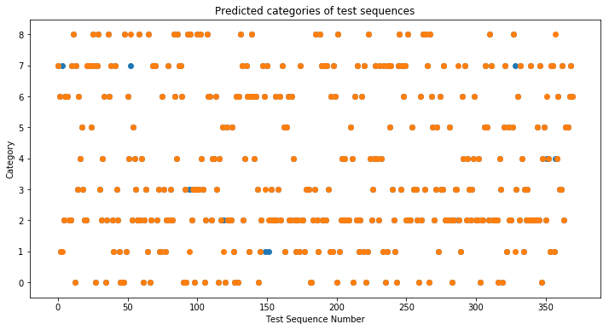
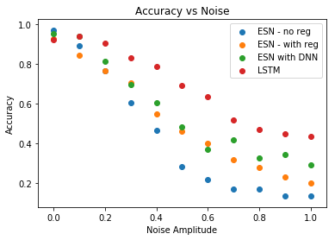
Reservoir computer on a personal laptop
Alpha, neuron size, and noise analysis
The training sequences were sent in order (i.e. all of Speaker 1’s sequences, then all of Speaker 2’s sequences, etc.)
The test sequences were sent in a random order
Incorrect predictions indicated by blue dots.
Reservoir size = 80, Leak rate = 0.8
Accuracy = 97.3%, Training time = 0.6 s
Experimentally
achieved regime
80 high-quality neurons are sufficient for classification, doable number for high-speed PIC

